Slide 1
QUATRO - a metadata platform for trustmarks
DC2005 Madrid
Phil Archer, ICRA

Slide 2

Typical trustmark

Slide 3
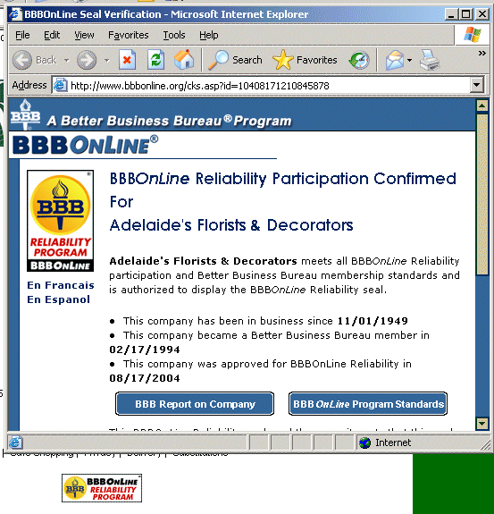

Slide 4
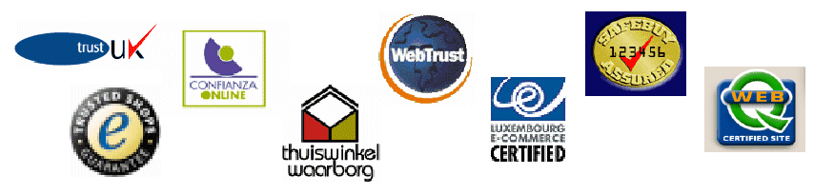



More trustmarks…

Slide 5
Quatro
Make trustmarks more interoperable
Make trustmarks machine-readable
Make trustmarks more attractive/valuable

Slide 6
A common vocabulary
General Criteria
Providing suitable identification information [Definition]
Use of clear language that is fit for purpose [Definition]
Privacy statement [Definition]
Data protection contact point [Definition]
Enforcement mechanism [Definition]
Meets legal practice in: [Definition]
Usability [Definition]
Downloads and plug-ins [Definition]
Cross-browser compatible [Definition]
Transparent domain name [Definition]
WAI Accessibility level [Definition]
Third-party content [Definition]

Slide 7
A common vocabulary
General criteria
Criteria for labelling to ensure accuracy of information
Criteria for labelling to ensure compliance with rules and legislation for e-business
Terms used in operating the trust mark scheme itself
  Issue date etc.

Slide 8
Advantages of a common vocabulary
More easily interpreted by generic tools
Users can see value of a trustmark even if previously unknown
Easier to use machine-learning to monitor adherence to code of practice

Slide 9
The technical platform (RDF-CL)
Make it easy to add RDF descriptions within a production company’s work-flow
Make it easy to re-use RDF descriptions
Make it really useful

Slide 10
Simple link
As Link tag
<link rel=“meta”
href=“http://www.example.org/labels.rdf”
type=“application/rdf+xml” />
As HTTP Response Header
Link: </labels.rdf>; /='/'; rel='meta'
type='application/rdf+xml'
Notes:
Now everything can include the same link tag and the client can sort out what it wants.
This is workable within the workflows of multi-national web properties. Labelling individual sub sites is generally not.

Slide 11
RDF-CL Ruleset example
<label:Ruleset rdf:ID="Ruleset">
<label:hasHostrestrictions>
<label:Hosts>
<label:hostRestriction>example.org</label:hostRestriction>
</label:Hosts>
</label:hasHostrestrictions>
<label:hasDefaultLabel rdf:resource="#label_1"/>
<label:hasDefaultManagementInfo rdf:resource="#mgt_1"/>
<label:rules rdf:parseType="Collection">
<rdf:Description>
<label:hasURI>associates</label:hasURI>
<label:hasLabel rdf:resource="#label_2" />
</rdf:Description>
</label:rules>
</label:Ruleset>
Notes:
Now everything can include the same link tag and the client can sort out what it wants.
This is workable within the workflows of multi-national web properties. Labelling individual sub sites is generally not.

Slide 12
RDF-CL Ruleset example
<label:Ruleset rdf:ID="Ruleset">
<label:hasHostrestrictions>
<label:Hosts>
<label:hostRestriction>example.org</label:hostRestriction>
</label:Hosts>
</label:hasHostrestrictions>
<label:hasDefaultLabel rdf:resource="#label_1"/>
<label:hasDefaultManagementInfo rdf:resource="#mgt_1"/>
<label:rules rdf:parseType="Collection">
<rdf:Description>
<label:hasURI>associates</label:hasURI>
<label:hasLabel rdf:resource="#label_2" />
</rdf:Description>
</label:rules>
</label:Ruleset>
Notes:
Now everything can include the same link tag and the client can sort out what it wants.
This is workable within the workflows of multi-national web properties. Labelling individual sub sites is generally not.

Slide 13
Management Info example
<label:ContentLabel rdf:ID=“mgt_1”>
<dc:publisher>CCLRC</dc:publisher>
<dc:language>en-gb</dc:language>
<dc:creator rdf:resource=http://www.bitd.clrc.ac.uk/Person/A.J.Miles />
</label:ContentLabel>

Slide 14
Applications
Semantic web browsers & applications
Traditional filters
VeryQ Toolbar & LADI => QUATRO proxy

Slide 15
QUAPRO (Quatro proxy)
Visits URL(s), looks for RDF-CL
Checks label as appropriate, e.g.
  database lookup
  Machine learning –based content analysis
Reports back to application

Slide 16
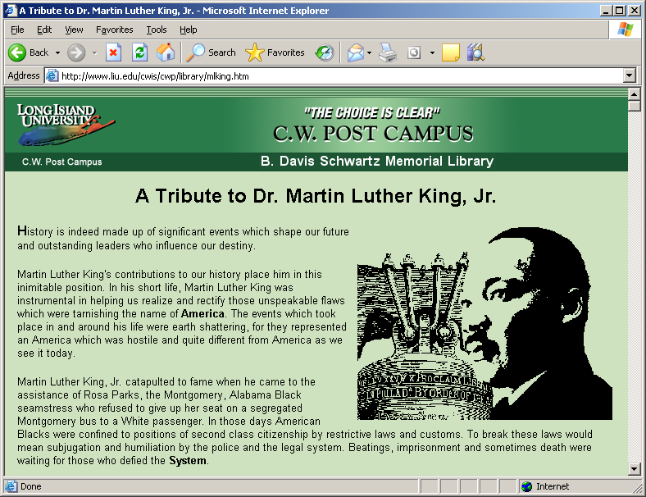
Trust what you find
Organisation X says this is really good for your homework
Notes:
Quality labels can be added to sites and interpreted by user agents

Slide 17
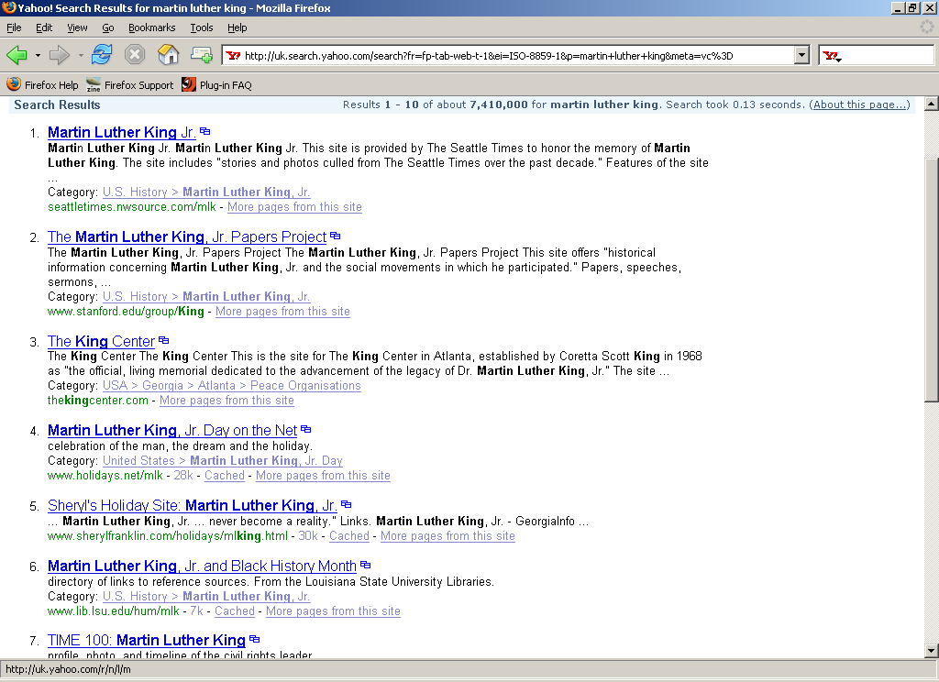
Resource discovery
Organisation X says this is really good for your homework
Notes:
Even better if you can seethe quality label before you go there.
System depends on trusting the trustmark. Various ways – DB lookup being most obvious in this scenario but there are others.

Slide 18
Suppose…
Everyone included structured metadata on their websites
You could check that metadata
What could you do with it?

Slide 19

www.icra.org
parcher@icra.org

